Slide 1

GlowBox
Food and Drink Banner A/B test

Slide 2

A/B test setup
The experiment is only being run on the mobile website.
Visitors of the GloBox main page randomly assigned to either the control or test group.
New banner is loaded for the test group, no banner is loaded for the control group
“Conversion” – visitor makes a purchase

Slide 3
A/B testing pre-conditions
The statistical confidence level 95%
Is statistical reliability indicator that measures the probability of the difference in the results observed between each sample (group) not being a matter of chance
It is acceptable to make a mistake in 5% of cases and for the results of the two versions to be identical. α = 0.05
Indicators to measure:
Average Amount Spent Per User
Conversion Rate
12 days A/B testing period:
from 25/01/2023 Wednesday
to 06/02/2023 Monday

Slide 4
A/B testing conditions
48 943 users involved in the A/B testing
24 343 users assigned to the control group
24 600 users assigned to the treatment group

Slide 5
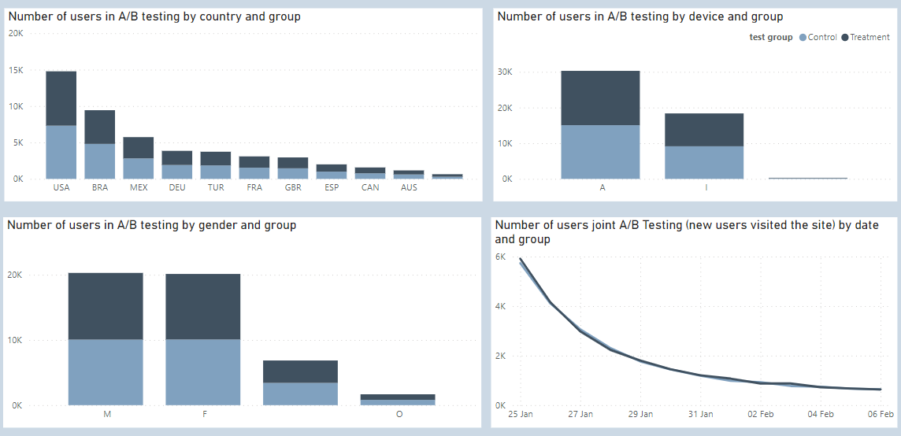
A/B test users

Slide 6
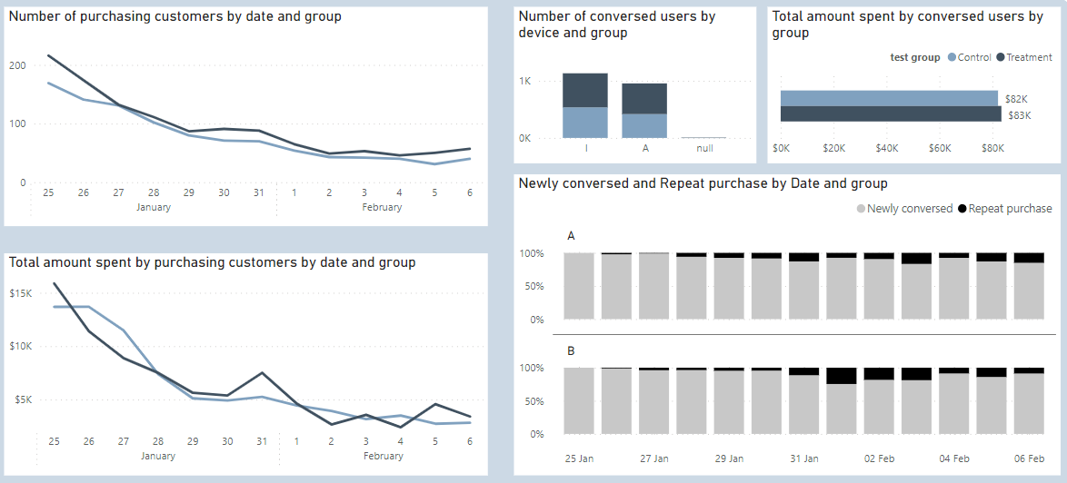
Conversion

Slide 7
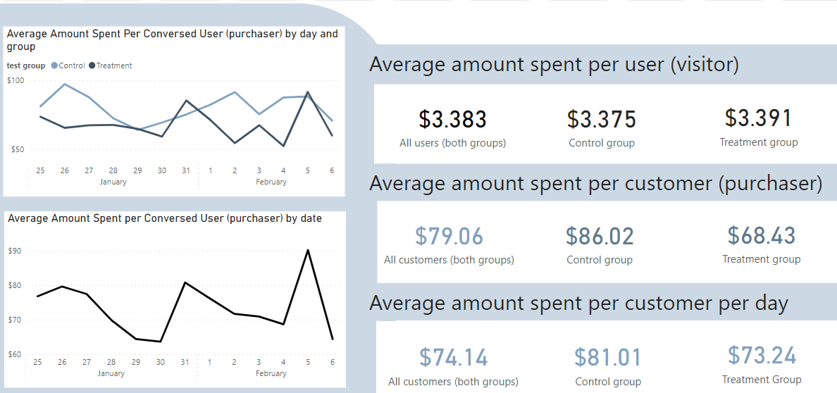
Average Amount Spent

Slide 8
Confidence interval Average Amount Spent per user
We are 95% confident that the interval (3.049, 3.700)
captured the true Average Amount Spent per user in the control group,
giving us the range of plausible values for the Average Amount Spent per user of the entire population of GlowBox users when the banner is not loaded
95% confidence interval for the average amount spent per user in the control group:
(3.049, 3.700)
95% confidence interval for the average amount spent per user in the treatment group:
(3.073, 3.708)
We are 95% confident that the interval (3.073, 3.708)
captured the true Average Amount Spent per user in the treatment group,
giving us a range of plausible values for the Average Amount Spent per user of the entire population of GlowBox users when the banner is loaded

Slide 9
Hypothesis test Difference in Average Amount Spent per user
α =0.05
H0: μ treatment - μ control = 0
Ha: μ treatment -μ control > 0
Where,
μ treatment is Average Amount Spent per user in the treatment group
μ control is Average Amount Spent per user in the control group
assuming unequal variance,
using the unpooled standard error
p value = 0.4721 ,
p>0.05 ,
fail to reject Ho, not enough evidence to reject the null hypothesis or
we don't have enough evidence that the average amount spent per user in the treatment group is greater than the average amount spent per user in the control group

Slide 10
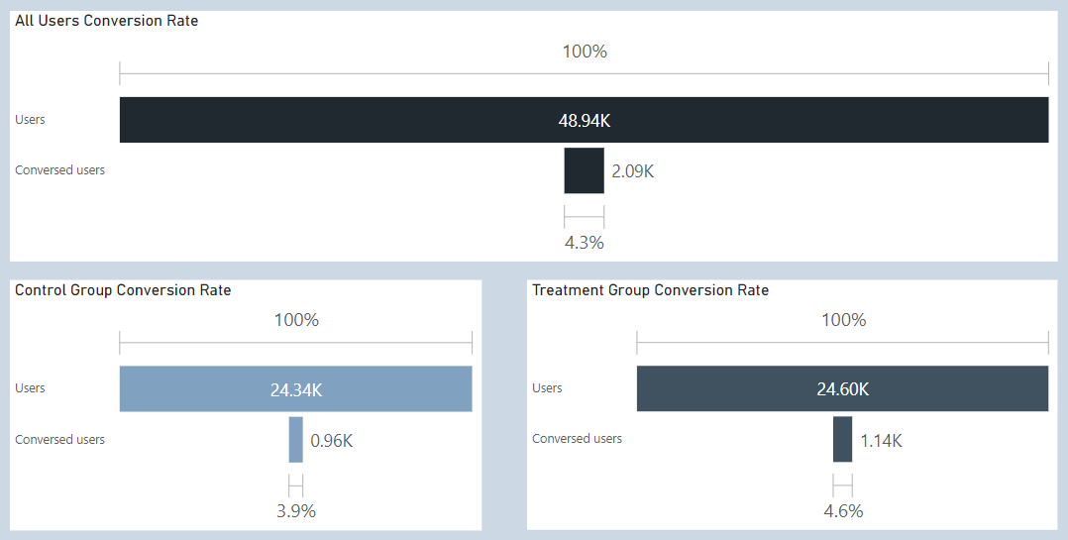
Conversion Rate

Slide 11
Confidence interval Conversion rate
95% confidence interval for conversion rate of users in the control group:
(3.68%, 4.17%)
95% confidence interval for conversion rate of users in the treatment group:
(4.37%, 4.89%)
We are 95% confident that the interval (3.68%, 4.17%)
captured the true Conversion rate in the control group,
giving us a range of plausible values for the Conversion rate of the entire population of GlowBox users when the banner is not loaded
We are 95% confident that the interval (4.37%, 4.89%)
captured the true Conversion rate in the treatment group, giving us a range of plausible values for the Conversion rate of the entire population of GlowBox users when the banner is loaded

Slide 12
Hypothesis test Difference in Conversion Rate per user
α =0.05
H0: P treatment - P control = 0
Ha: P treatment - P control > 0
Where,
P treatment is Conversion rate in the treatment group
P control is Conversion rate in the control group
p value = 0.000056 ,
p<0.05 ,
reject H0 and accept Ha ,
the evidence suggests that conversion rate in the treatment group is greater than the conversion rate in control group

Slide 13
Conclusion A/B testing process
Test over incomplete period
Conversion rates can vary massively on different days of the week and even at different times of the day so a normal range of conversions should be respected
Better to test over at least one business cycle and ideally two
Internet users do not make a purchase as soon as they come across the site
More than 12 days might elapse between the time users are the subject of the test and the point at which they convert

Slide 14
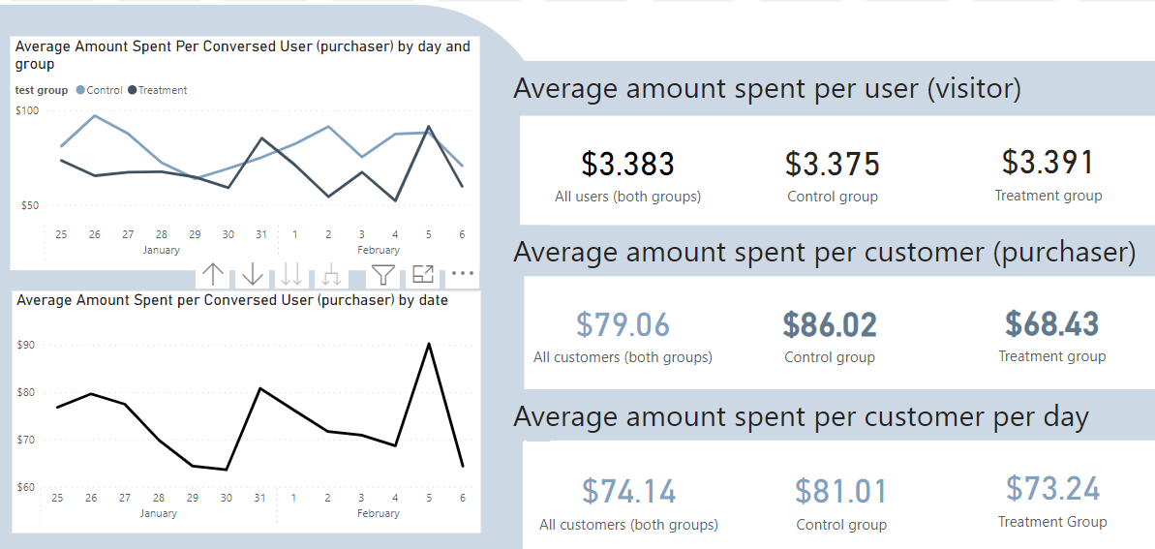
Conversion rate increases, average amount spent per customer decreases
With the increase of conversion rates (e.g. thanks to a new, cheaper product), average amount spent per customer goes down (even though average amount per user stay the same) – the differences between these should be tracked, as a gap too large might be negative for the sales
Conclusion A/B testing process results
Revenue could be calculated as a product of 3 factors:
Traffic
Conversion Rate
Average Amount Spent Per Customer (Conversed User)

Slide 15
Conclusion
The gap between average amount spent per customer and increased conversion rate should be considered to avoid negative impact on sales before launching the experience to all users. There was no data available about the purchased products to conduct a research.
Possible sources of issues:
pricing strategy
marketing strategy
discount policy

Slide 16
Thank you

